Slide 1

PREDICTION OF MOVIE RATINGS
Team Number: 12
Team Members:
Kinjal Bhatia (002776038),
Divya Dubey (002776608)
Subject: INFO6105 Data Science Engineering Methods and Tools

Slide 2
INTRODUCTION
Film industry give rise to a large number of movies in a year. But only a few make it upto the mark.
Movie industry specialists also agree that it is a key success factor of movies to use analysis and prediction techniques which helps movie production companies and investors achieve financial success.
We aim to rate the movies and then find the difference which will help gain the results of the accuracy of particular model.

Slide 3
We also hope to offer insight on the determining factors of film ratings that will guide producers through film promotions.
To predict movie ratings, we have researched various features and evaluated their performance in the prediction accuracy. We have used KNN, decision tree, random forest and linear regression as input algorithms for our movie dataset.

Slide 4
MOTIVATION
The objective of this project is to learn from the data and predict the ratings which will also predict which algorithms have the proper accuracy in rating the movies regarding the dataset.
The end results of this prediction model will be to check the accuracy of various machine learning models and then differentiating them.
There is no particular formula for analyzing and calculating the net gross a movie could earn. However by analyzing revenues from movies, a prototype can be built be such that it could be predicting the estimated income for a specific film.

Slide 5

DESCRIPTION OF THE DATASET
The link of our dataset is:
https://www.kaggle.com/datasets/akshaypawar7/millions-of-movies
Dataset has been collected from an updated dataset file which consists of metadata for more than 700,000 movies listed in the IMDB dataset. The dataset is updated daily to ensure the updated movies are in the dataset.
Ratings are on the scale of 1 to 10.

Slide 6
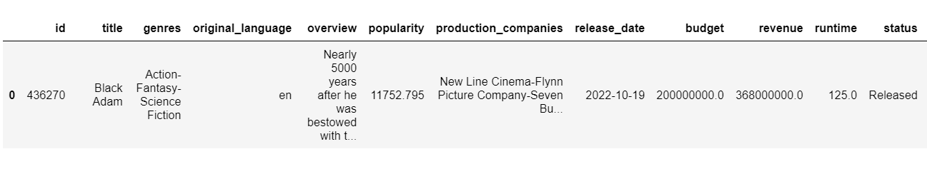
Certain data points include cast, crew, plot keywords, budget, revenue, posters, release dates, languages, production companies, countries, IMDB vote counts and vote averages, reviews, recommendations.
IMDB vote counts and vote averages, reviews, recommendations, are included.

Slide 7
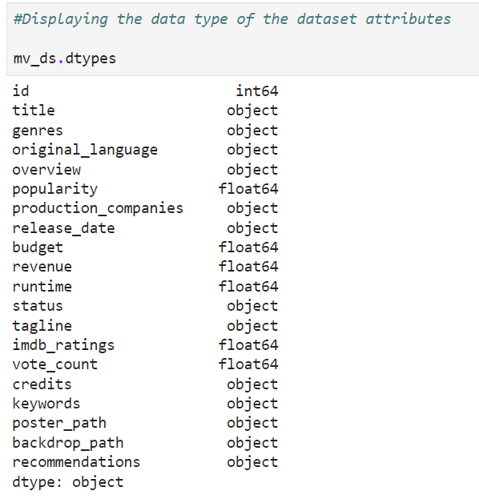

Slide 8
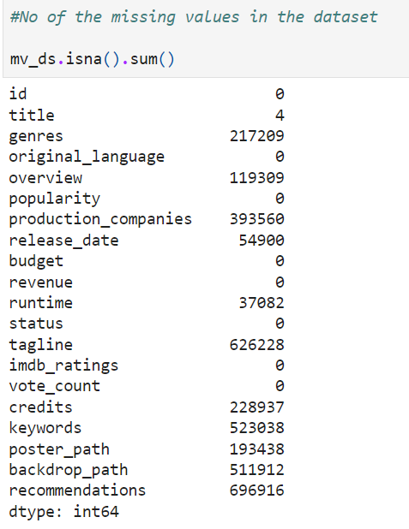
DATA CLEANING
We have dropped columns, like poster_path, Backdrop_path, recommendations, that aren’t relevant to or updated for new movies using pandas’ .drop() function.
Categorical data, dropna, drop columns and removing duplicate function is used for clearing the unwanted data and focusing on target data.

Slide 9
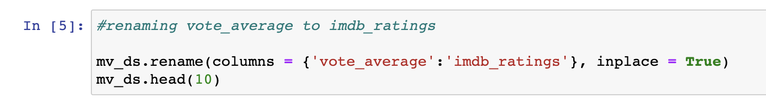
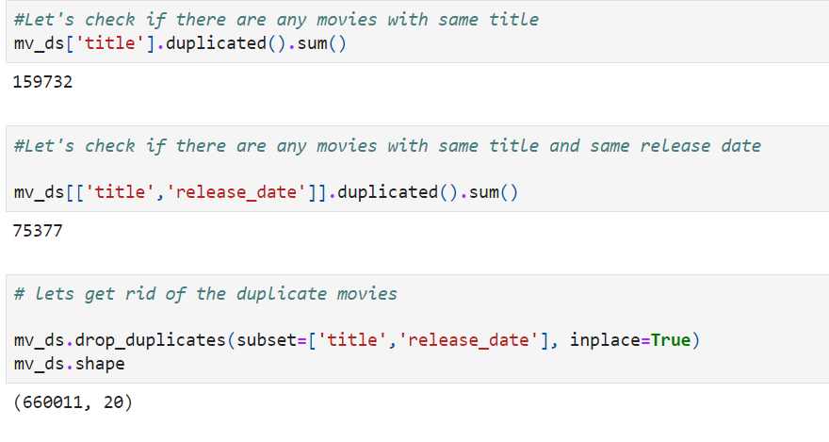
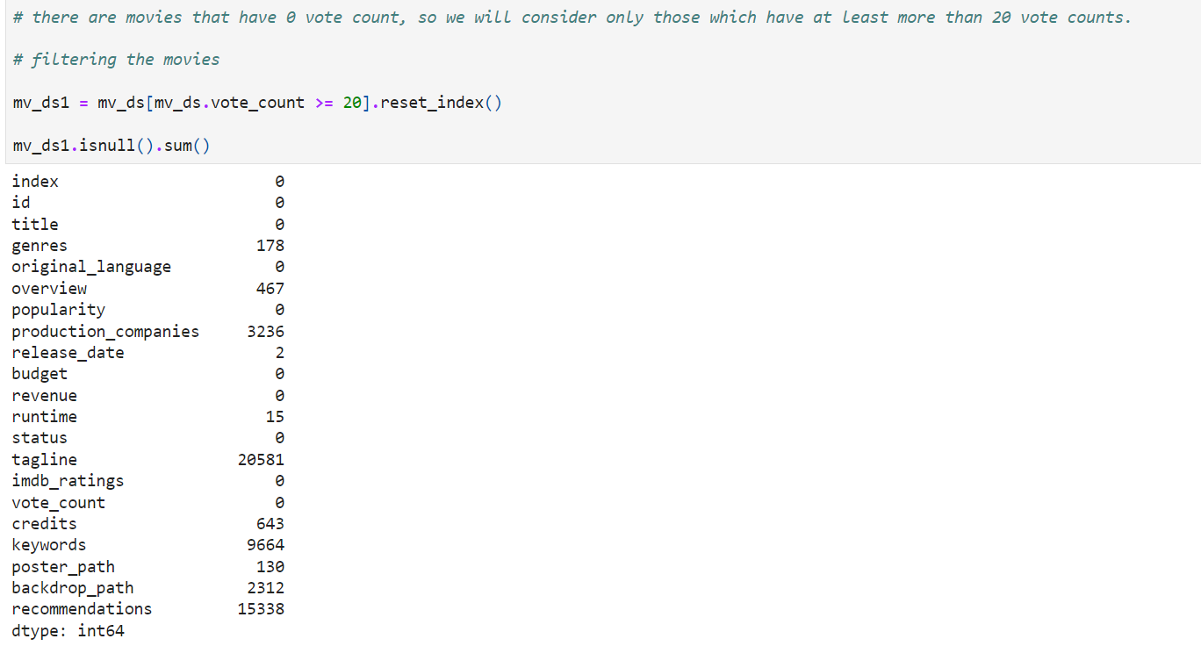

Slide 10
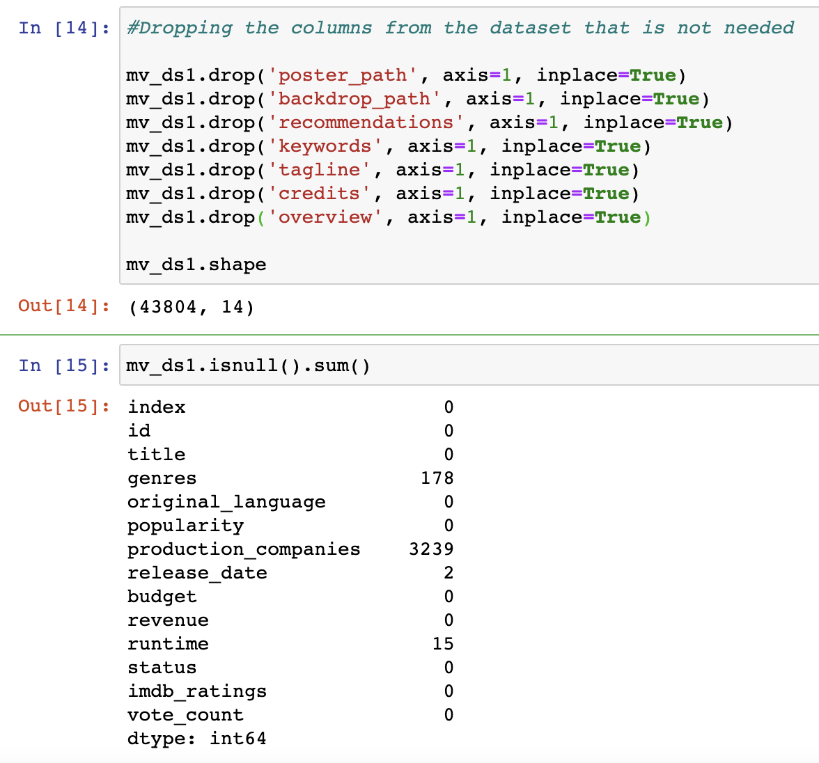
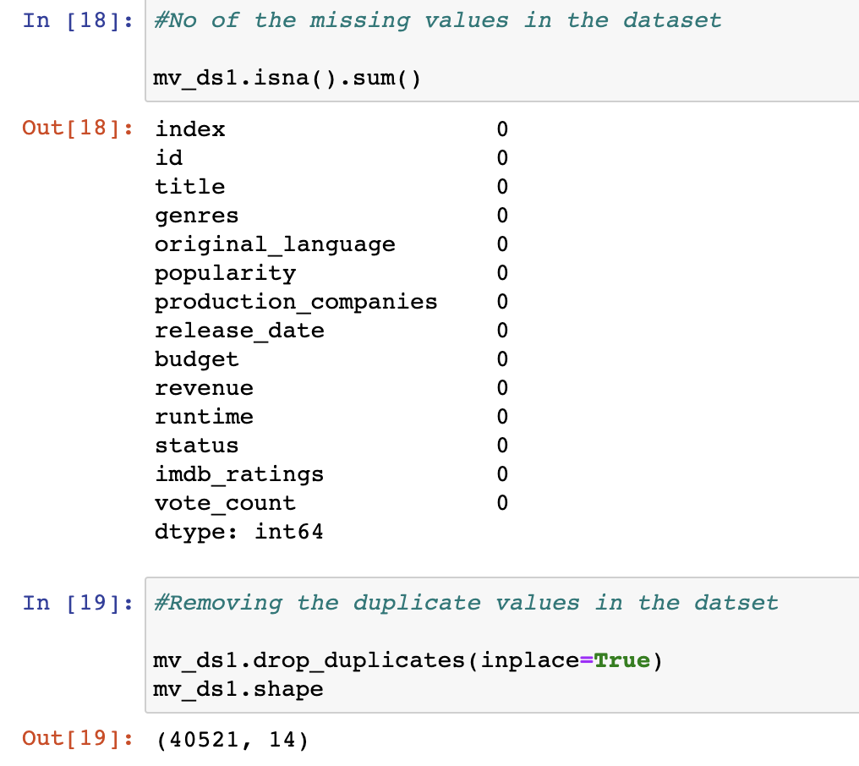

Slide 11
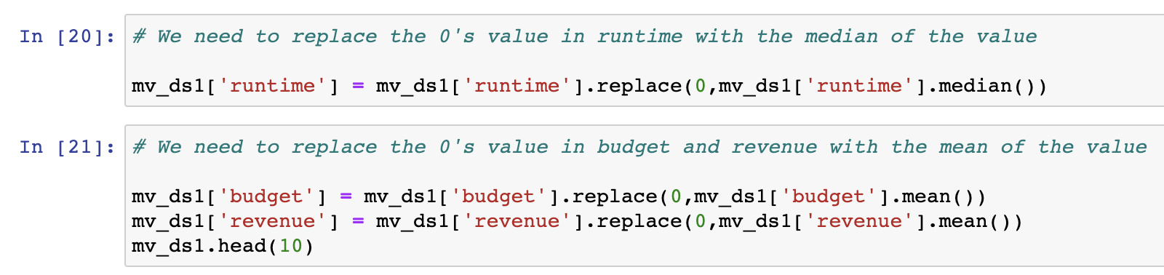
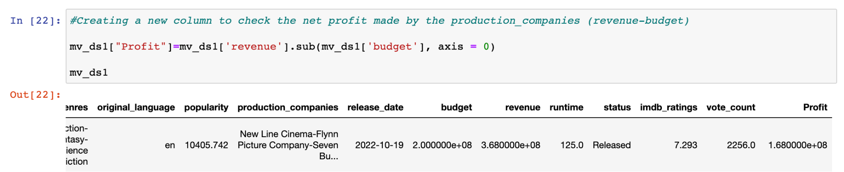
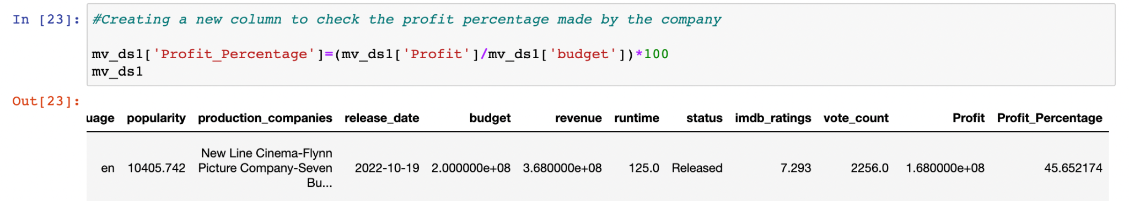
We have eliminated the null values from the raw data, and also wherever needed we had replaced null with the median.
Here, we also have created a new column to check the overall net profit and its percentage gained by the production houses.

Slide 12
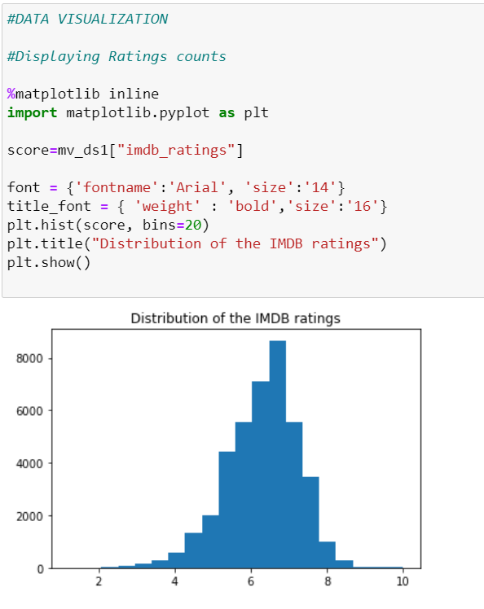
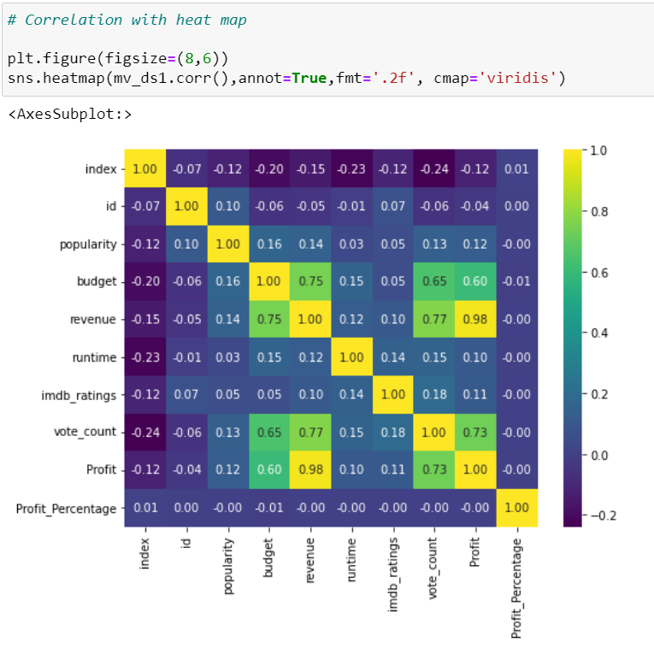
DATA VISUALIZATION

Slide 13
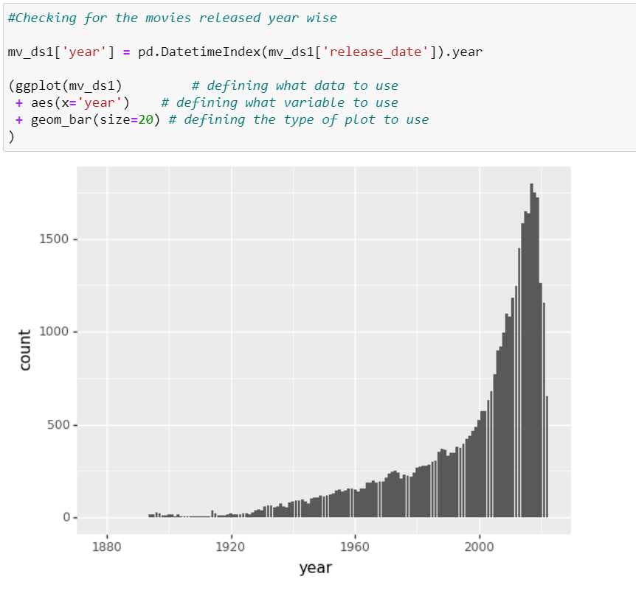
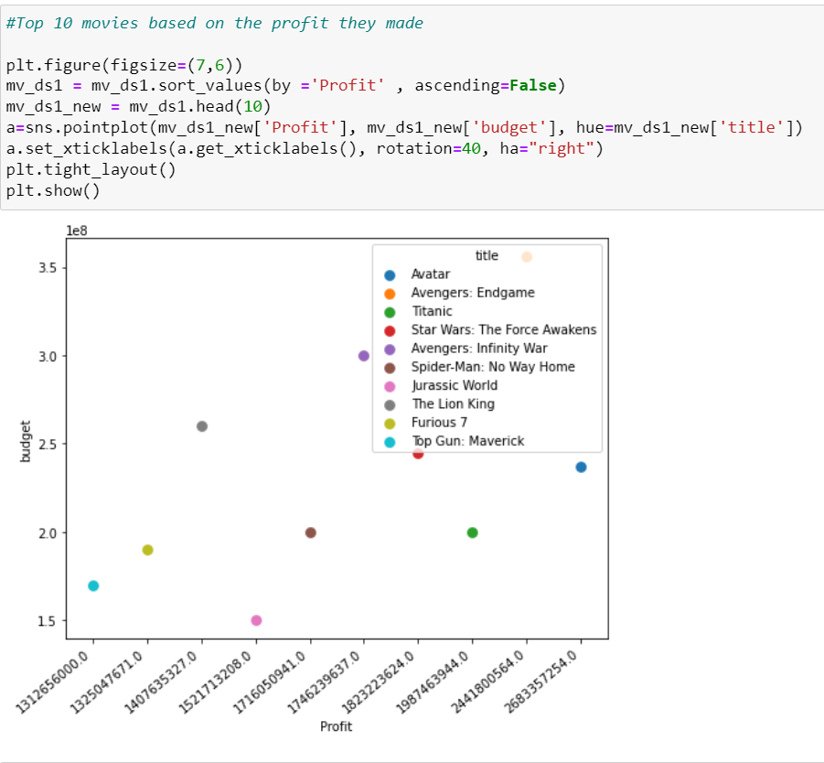

Slide 14
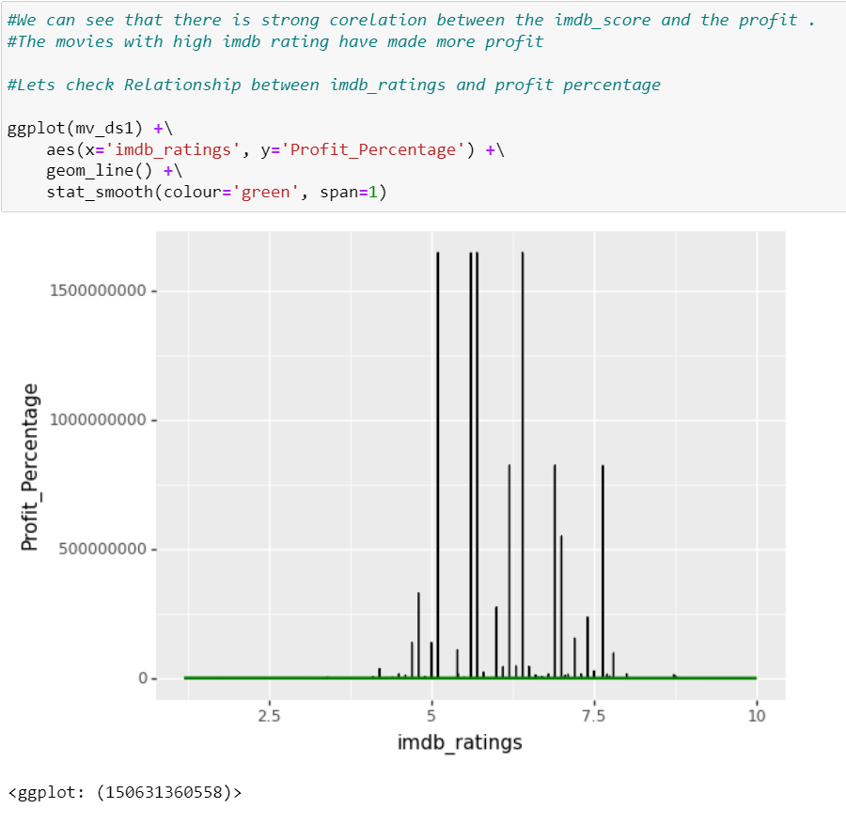
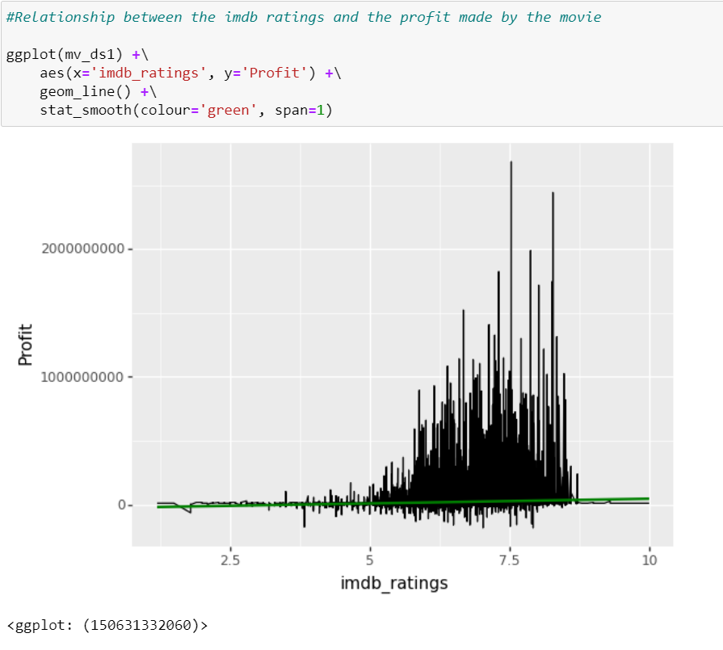

Slide 15
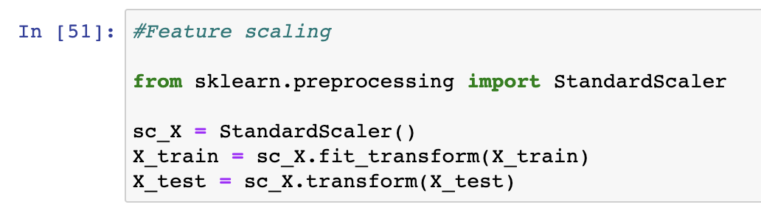
FEATURE SCALING
StandardScaler is been used which is used when the input dataset differ greatly between their ranges. It removes the mean and scales the data to the unit variance.
Here, the variables that are measured at different scales do not contribute equally to the fit of the model and the learning function of the model and could end up creating a bias.

Slide 16
METHODOLOGY USED
KNN
Decision Trees
Random Forest
Linear Regression

Slide 17
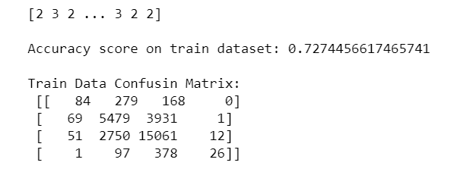
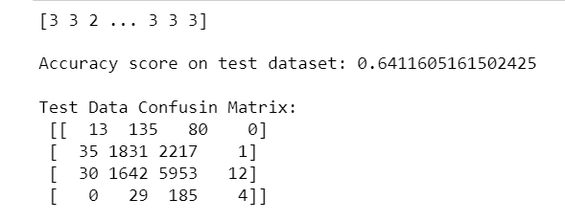
MODELS AND THEIR ACCURACY
KNN Algorithm
The KNN algorithm uses 'feature similarity' to predict the values of any new data points. This means that the new point is assigned a value based on how closely it resembles the points in the training set.
KNN is one of the more intuitive algorithms for the purpose of movie rating prediction, which made it interesting to analyze its’ usefulness.

Slide 18
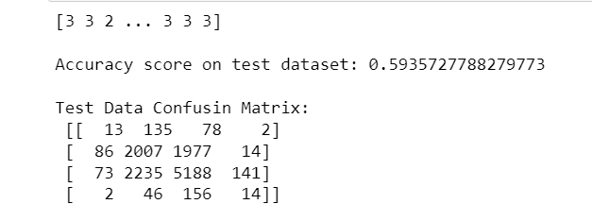
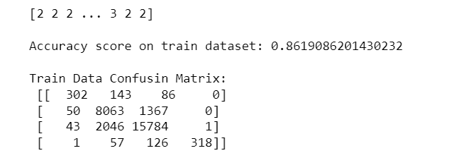
Decision Trees
A decision tree contains internal nodes corresponding to input features, and leaves, which represent the output value following certain paths from the root.

Slide 19
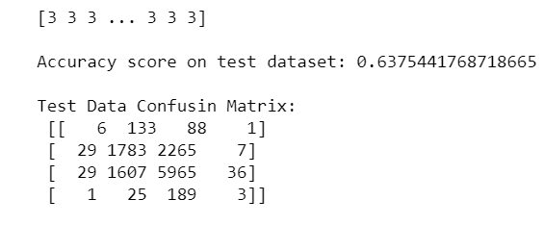
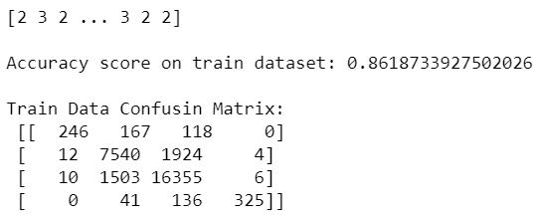
Random Forest
Random forest is a technique used in modeling predictions and behavior analysis and is built on decision trees.
It contains many decision trees representing a distinct instance of the classification of data input into the random forest.
It’s a process that operates among multiple decision trees to get the optimum result by choosing the majority among them as the best value.

Slide 20
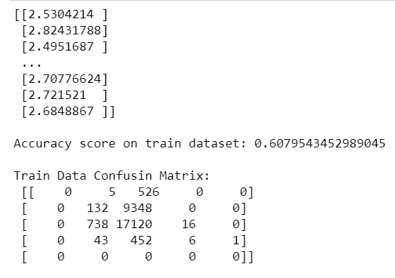
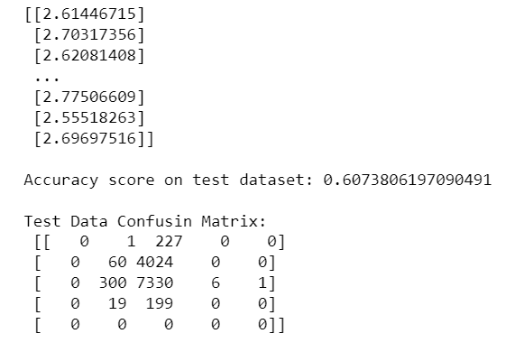
Linear Regression
Linear regression is one of the most used predictive modelling techniques. It is represented by an equation 𝑌 = 𝑎 + 𝑏𝑋 + 𝑒, where a is the intercept, b is the slope of the line and e is the error term. This equation can be used to predict the value of a target variable based on given predictor variable(s).

Slide 21
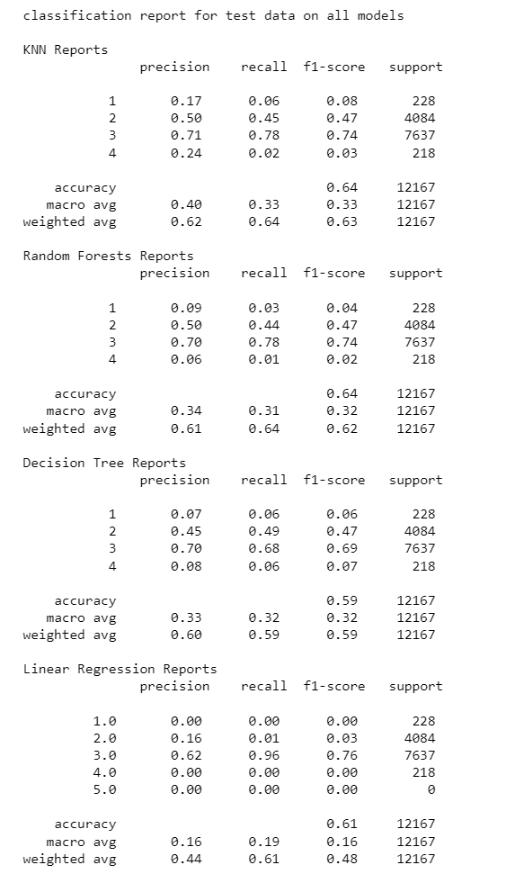
RESULTS
Random Forest Model and KNN Model provided the highest accuracy for test dataset.
The highest accuracy score is 64% with 7,00,000 rows corresponding to a number movies being evaluated.

Slide 22

CONCLUSION
We had to visualize and analyze combinations of features because no single feature can accurately predict ratings of new movies. Yet, there are other numerous combinations that can affect the ratings differently than the individual values would indicate.
Movie industry specialists agree that it is a key success factor of movies and helps movie production companies and investors gain financial success.

Slide 23
REFERENCES
https://www.kaggle.com/datasets/akshaypawar7/millions-of-movies
https://www.kaggle.com/datasets/netflix-inc/netflix-prize-data
https://medium.com/web-mining-is688-spring-2021/predicting-imdb-ratings-of-new-movies-2b39459fee9a
https://ieeexplore.ieee.org/document/9076540
https://link.springer.com/article/10.1007/s42979-021-00592-x#Sec15
https://www.kaggle.com/code/bhsraman/predict-movie-ratings-via-machine-learning/data

Slide 24


